Slide 1
MagSails - Sep. 2 update
Codes for magnetic field and MHD simulations

Slide 2
magpylib
Python package for calculating magnetic fields of magnets, currents and moments.
Free, open source code from Silicon Austria Labs
Easy set up and runs to compute vacuum magnetic fields for current carrying wires.

Slide 3
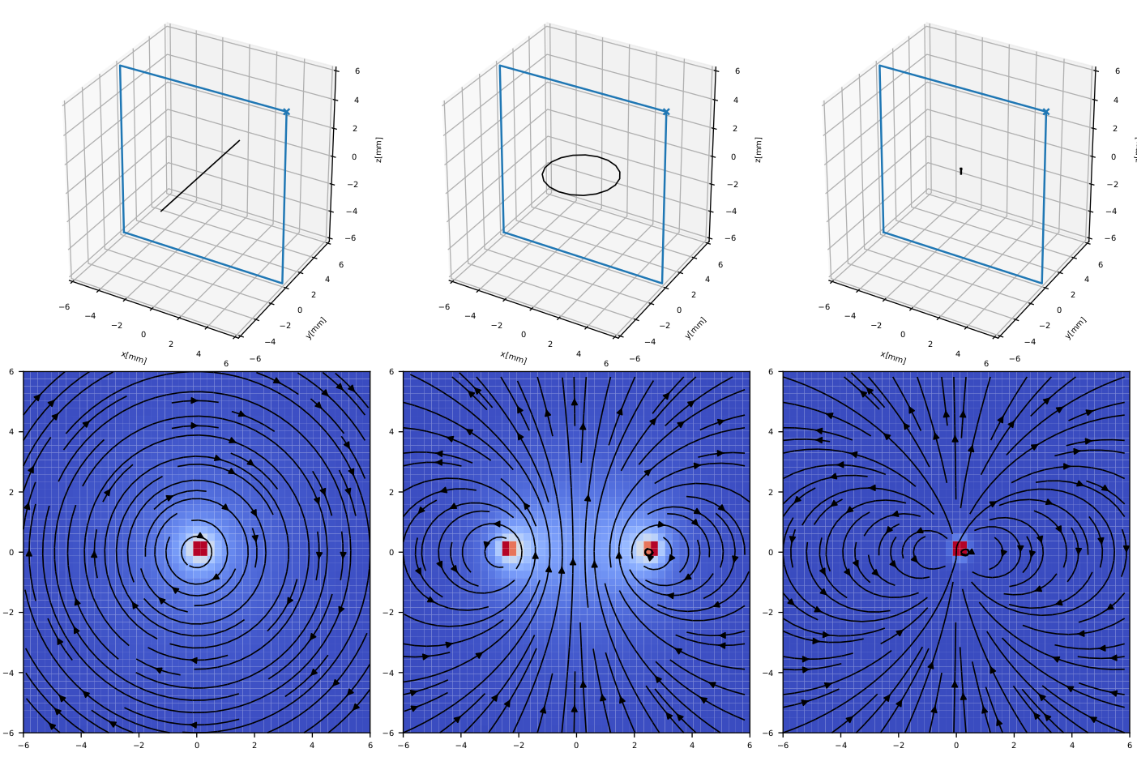
Wire
Circular loop
Square loop

Slide 4
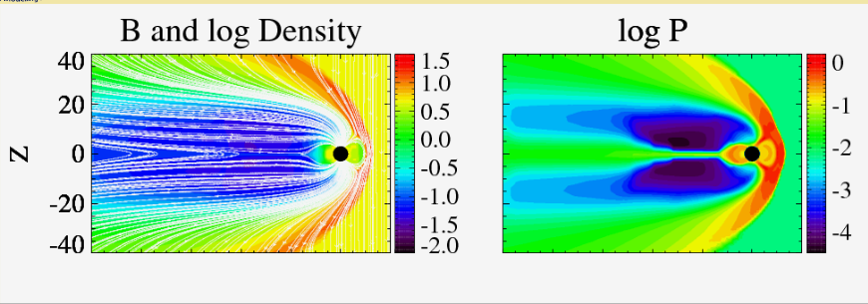
Space Weather Model
MHD code used for space weather and magnetosphere simulations.
Free for use, from University of Michigan
Need to request software using an online form.
Should be able to capture shock front, if we are able to set it up properly.
Complex package, many intricacies!
SpacePy provides visualization for model output

